Slide 1

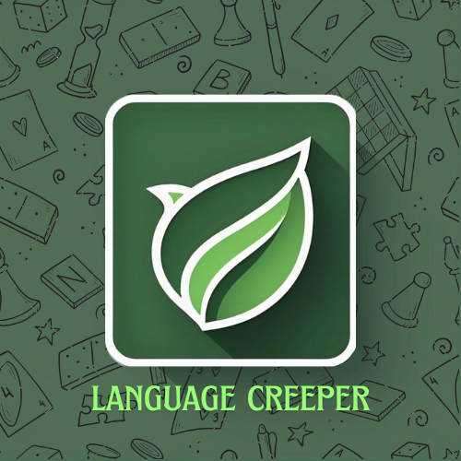
LANGUAGUE
CREEPER

Slide 2


Introduction
Purpose
Target Audience
Ideology
A platform to learn programming languages interactively
Beginners and intermediate learners interested in coding
Designed to make learning coding fun , ensuring a enjoyable experience

Slide 3

Process
Login
Or
Signup
Select
language
Learn with
Guide & Flashcard
Test yourself with Quiz and Games

Slide 4


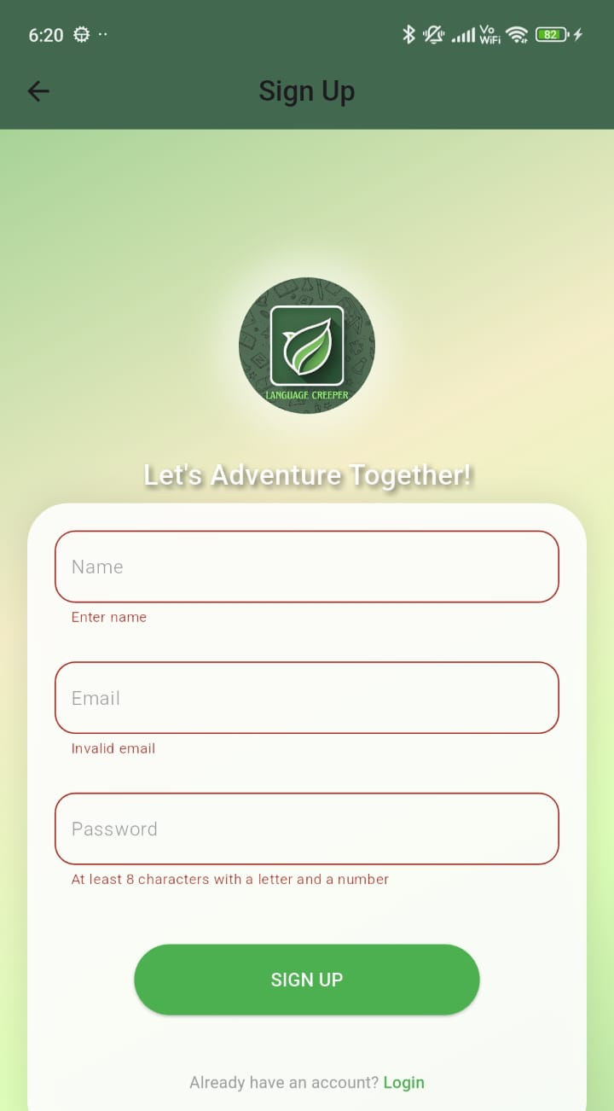
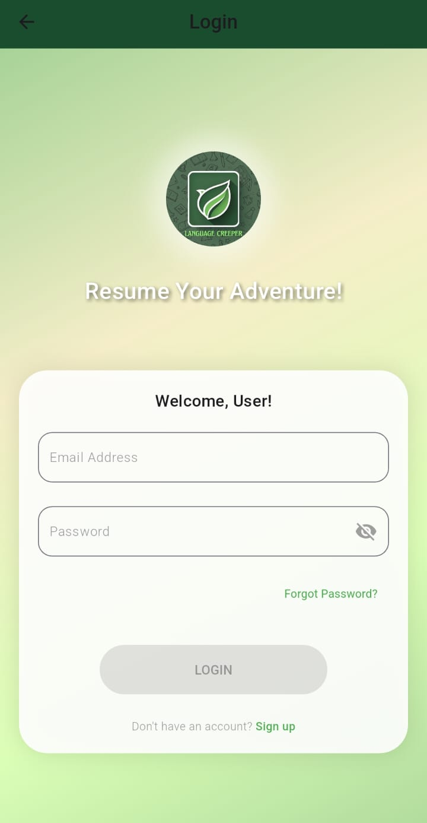

Login & Accessibility Page
Simple and user-friendly login interface for easy access
Allows users to create accounts and save progress.
Seamless navigation to the main learning sections after login.

Slide 5
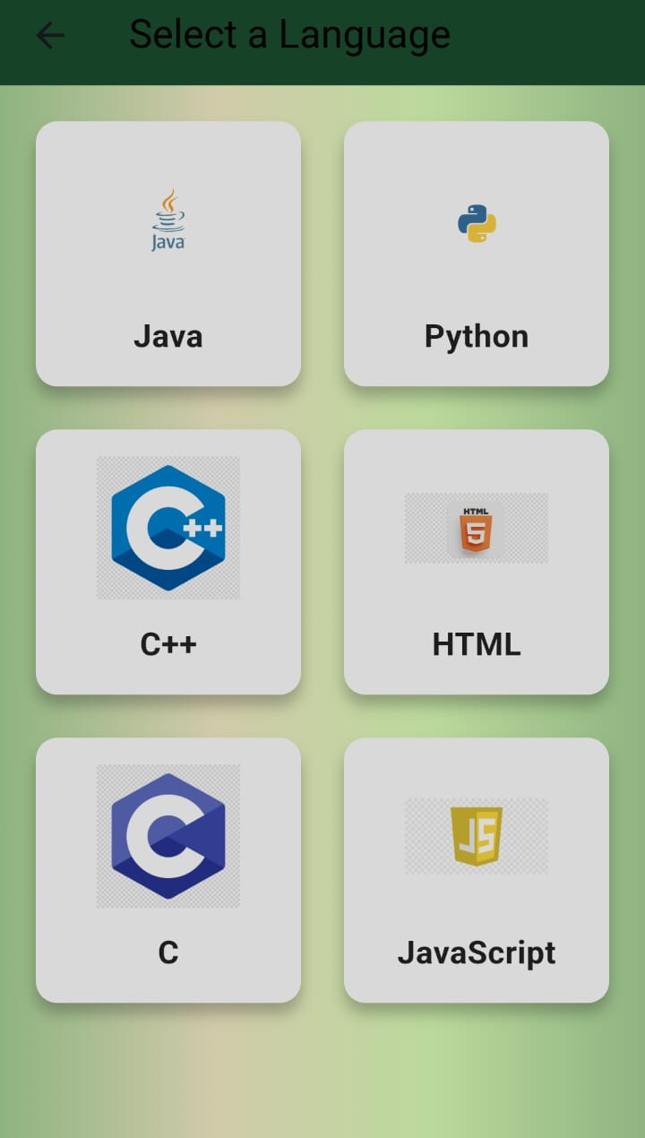
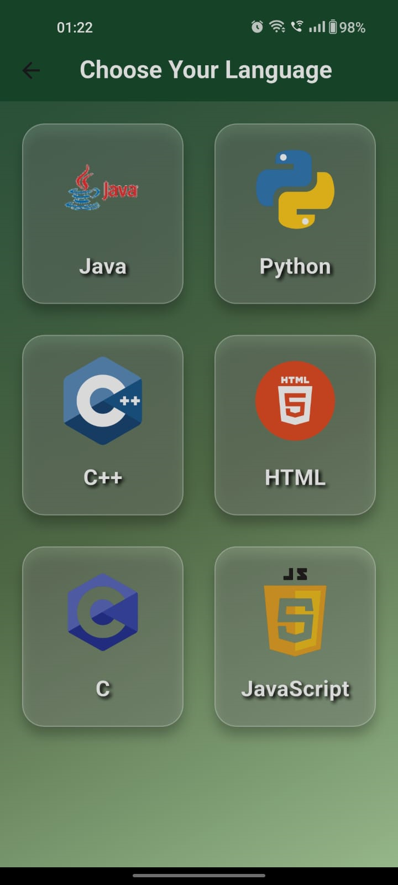

Language Selection Screen
Users can choose from multiple programming languages: Java, Python, C++, C, HTML, JavaScript
Clean and simple UI for easy navigation
Provides a structured learning path for each language

Slide 6
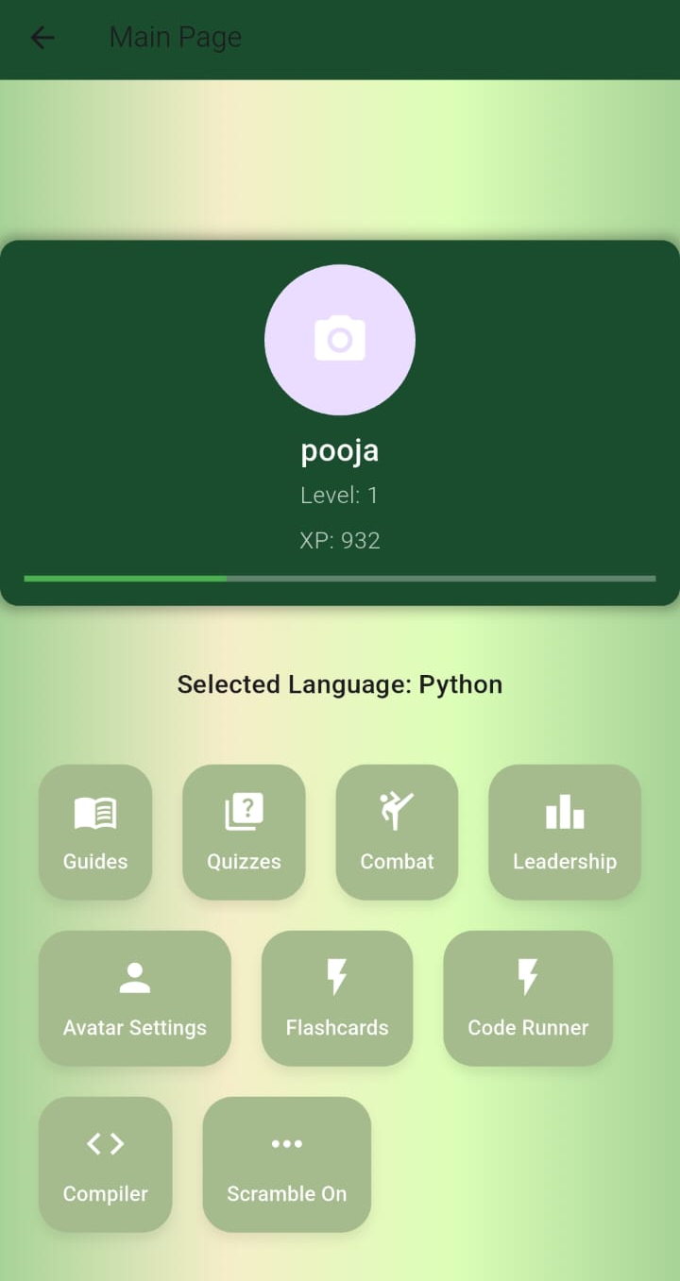
Main Page
This displays all the activities in the app

Slide 7
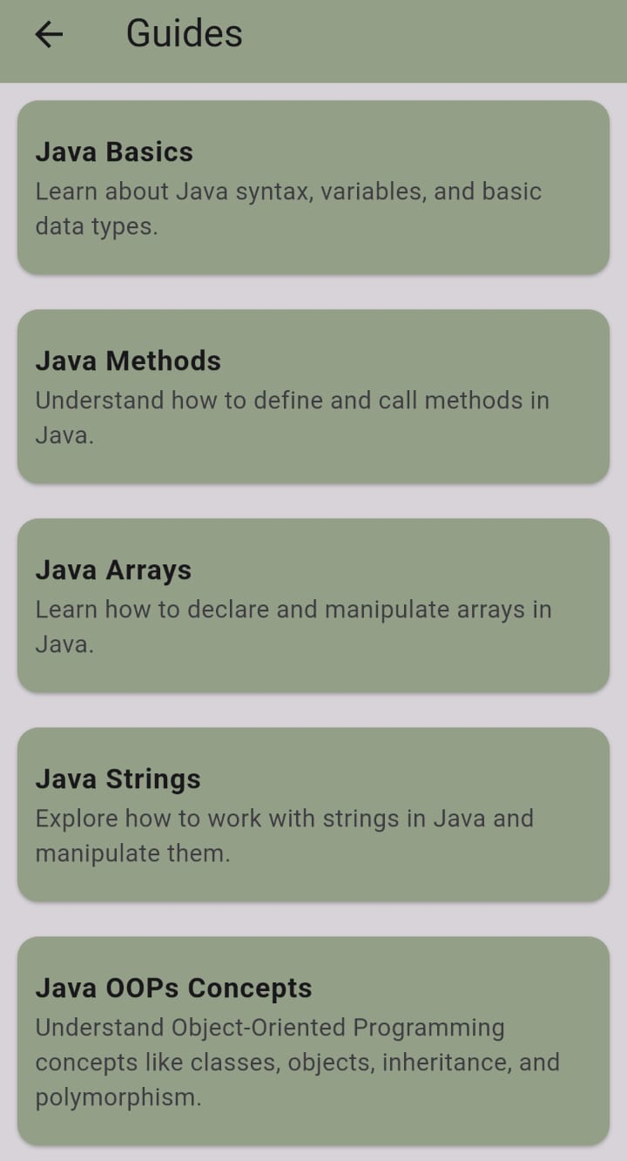
Guides
Users can explore the language basics through categorized guides
Interactive learning with step-by-step guidance
Ensures fundamental understanding before moving to advanced topics

Slide 8
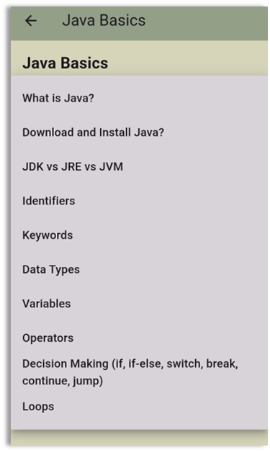
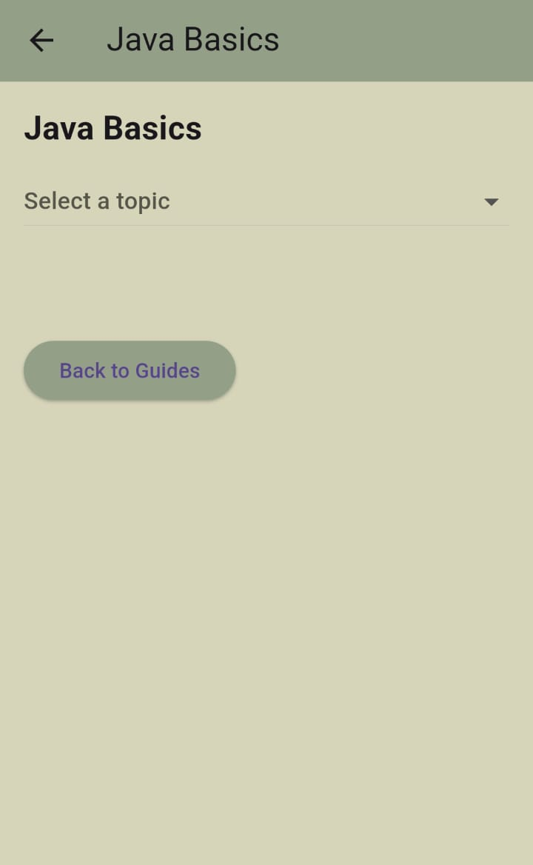
Subtopics in
Guides
Explanation of the
Sub Topics

Slide 9
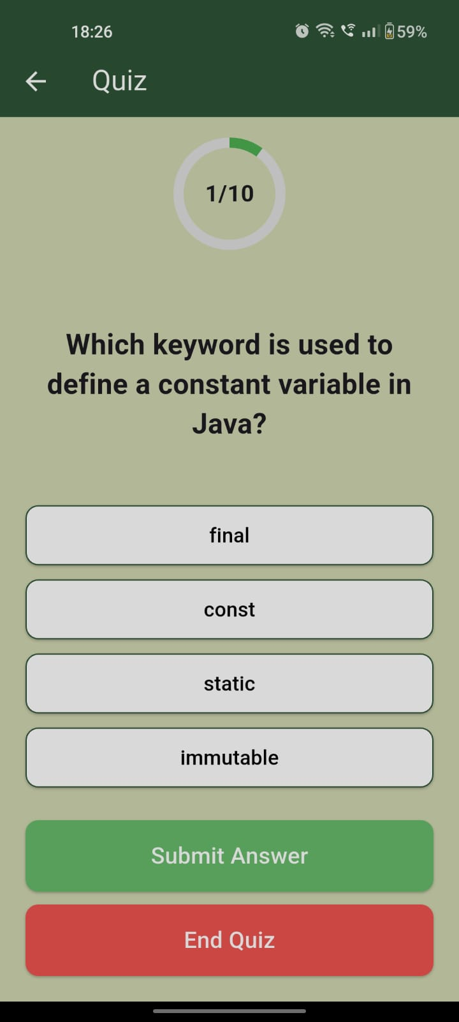
Quiz Feature
Helps users test their knowledge with multiple-choice questions.
Tracks progress with a score counter
(e.g., 1/10 questions completed)
Engaging UI with a Submit Answer and End Quiz button.

Slide 10
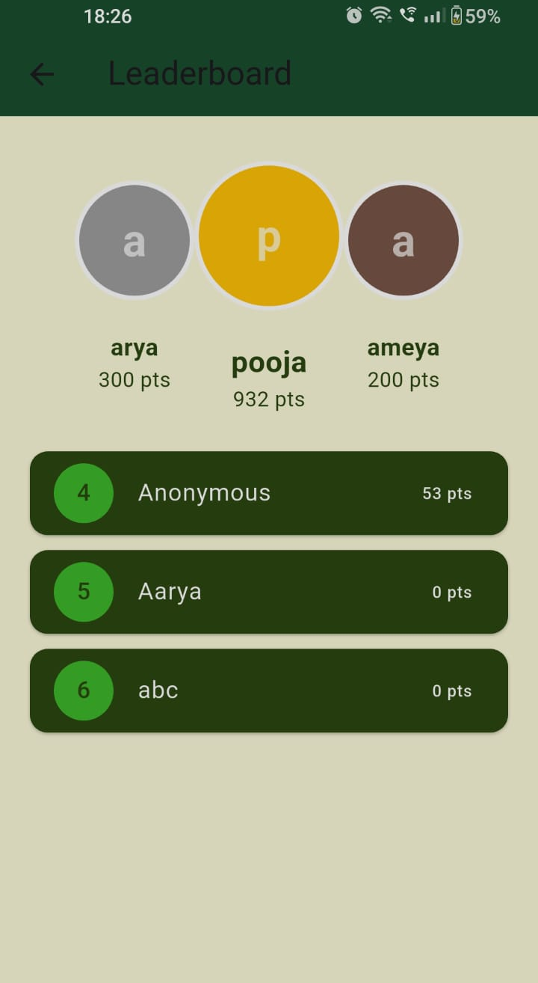
Leaderboard & User Engagement
Encourages healthy competition among users.
Displays top-performing users based on quiz scores.
Motivates learners to improve through gamification
Enhances engagement by rewarding consistent learning.

Slide 11
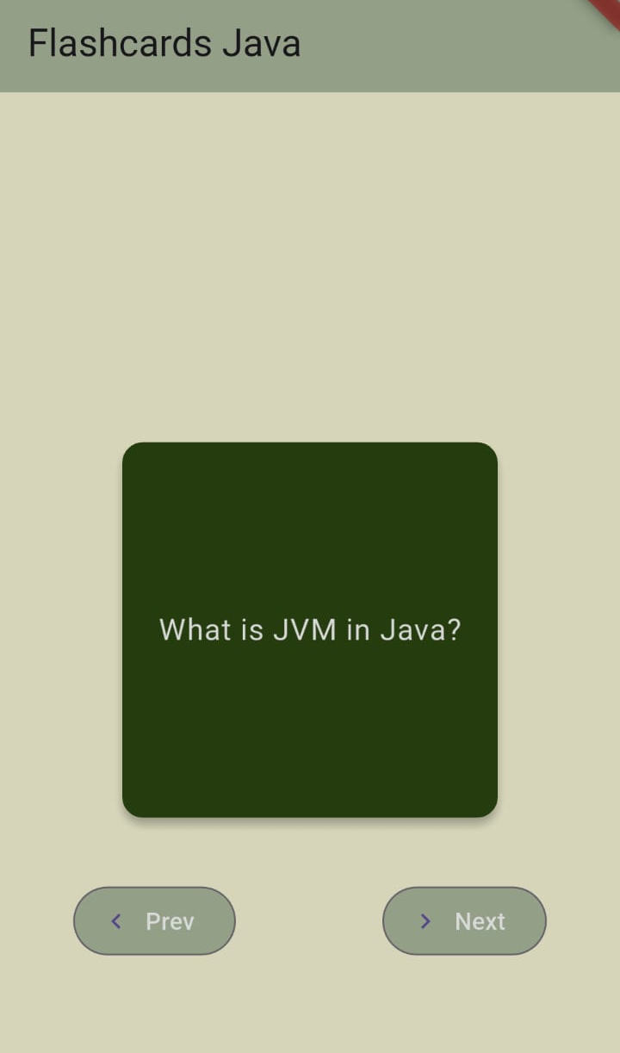
Interactive Flashcards
Simplifies learning with bite-sized information.
Helps users quickly revise key concepts.
Engages learners through an interactive experience.
Boosts memory retention with an easy flip-through format.

Slide 12
Fun Learn Games
01
Code Runner
02
Scramble On
03
Coding Combat

Slide 13

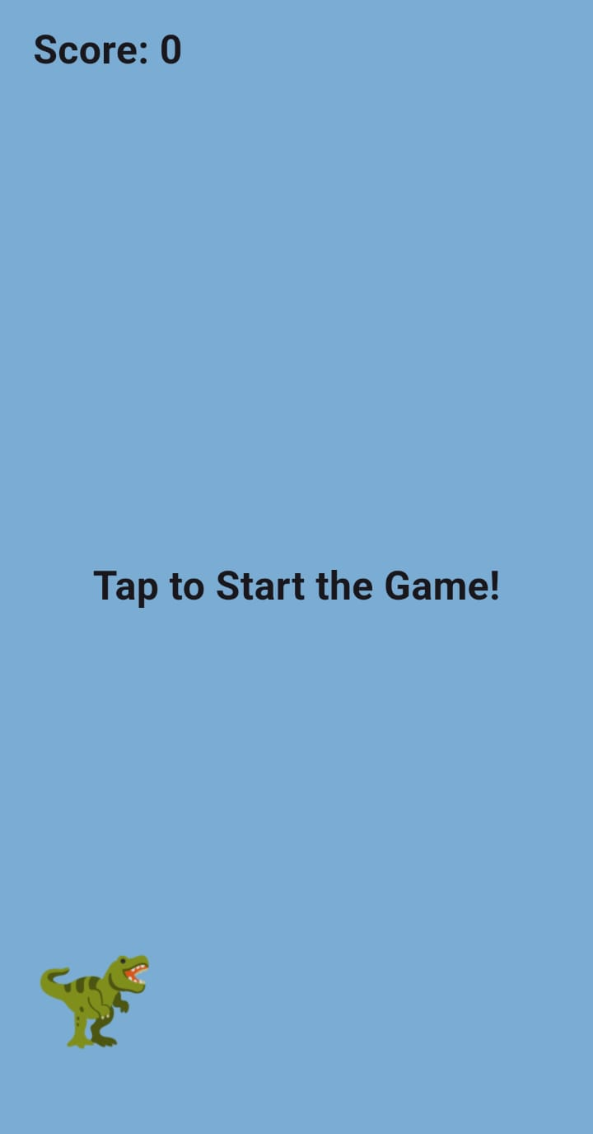
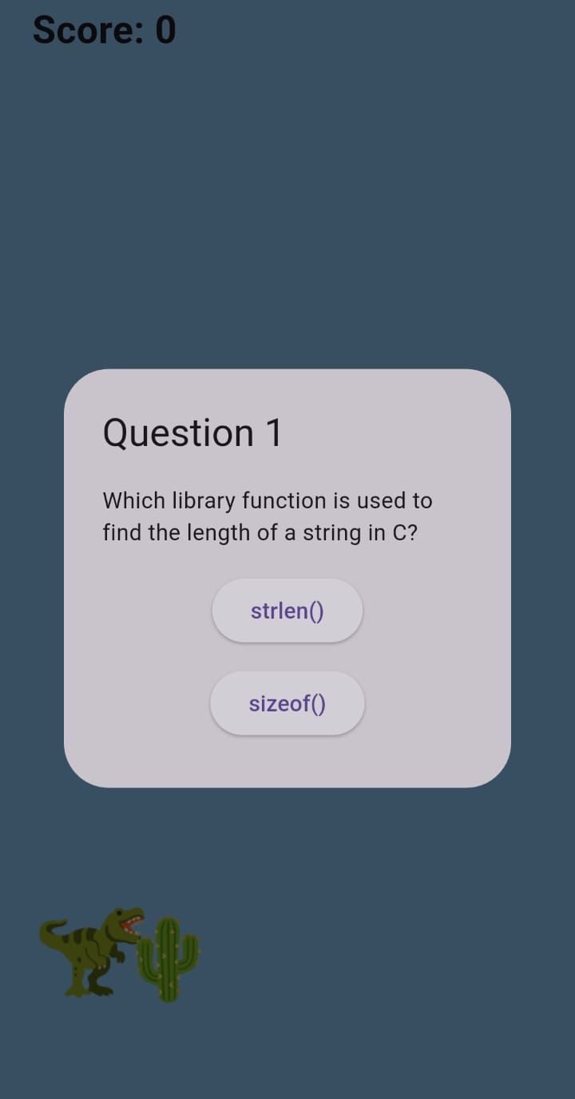
Code Runner
Running dinosaurs avoids obstacles but once collided it pops up a question that needs to be solved to continue

Slide 14
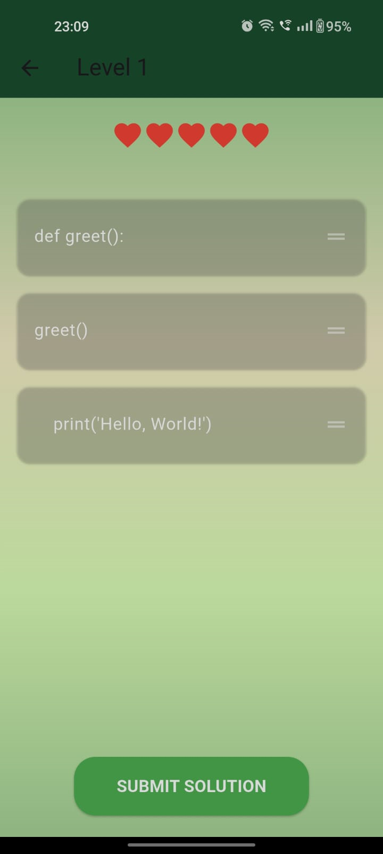
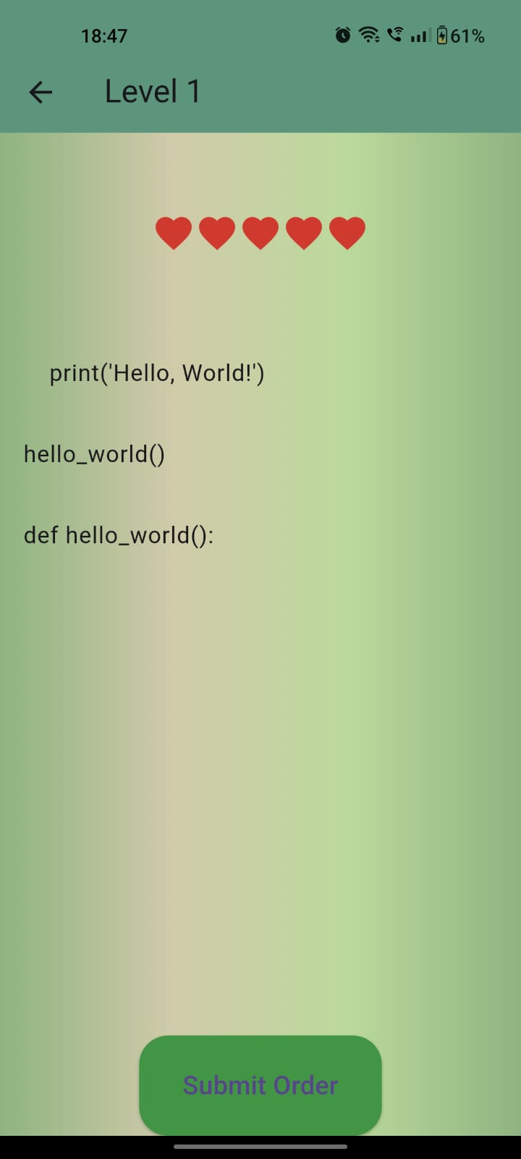
Scramble On
Scramble game which will show a scrambled code and you need to adjust it correctly to pass the level

Slide 15
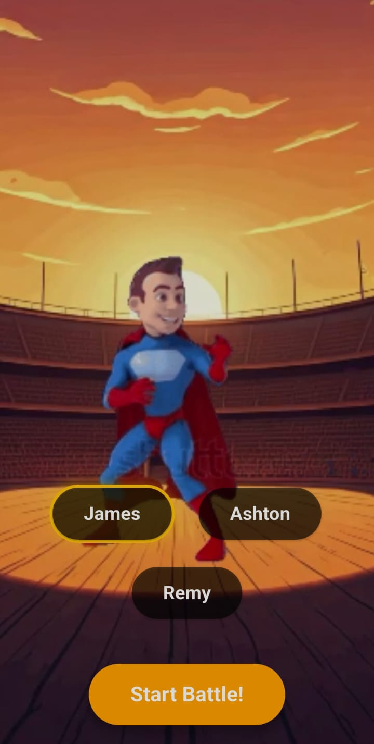
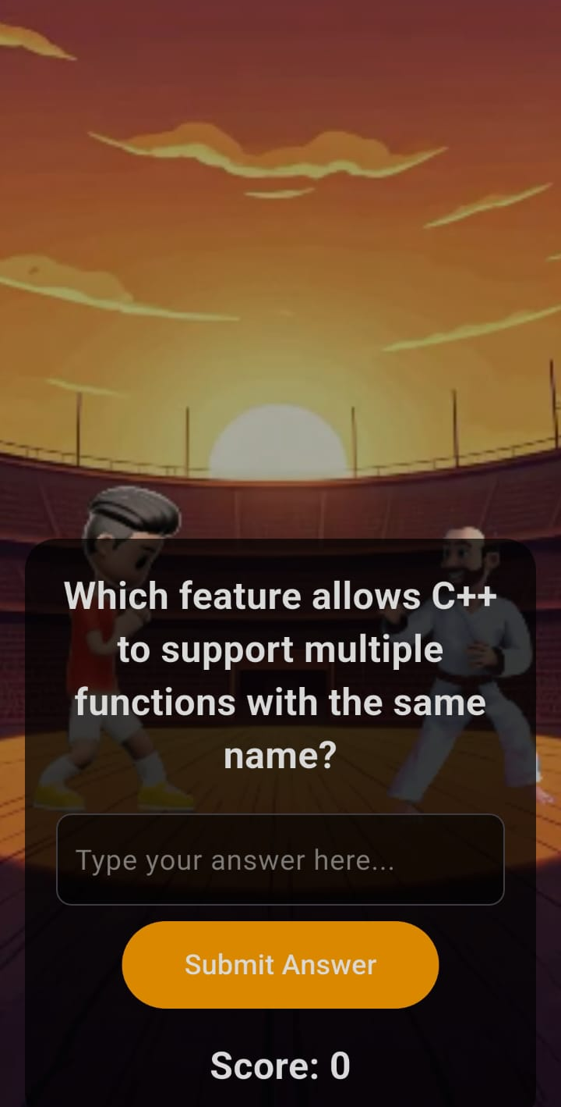
Coding Combat
Coding Combat allows the user to choose a character and then solve questions and the score increases and decreases depending on whether you answer right and wrong

Slide 16
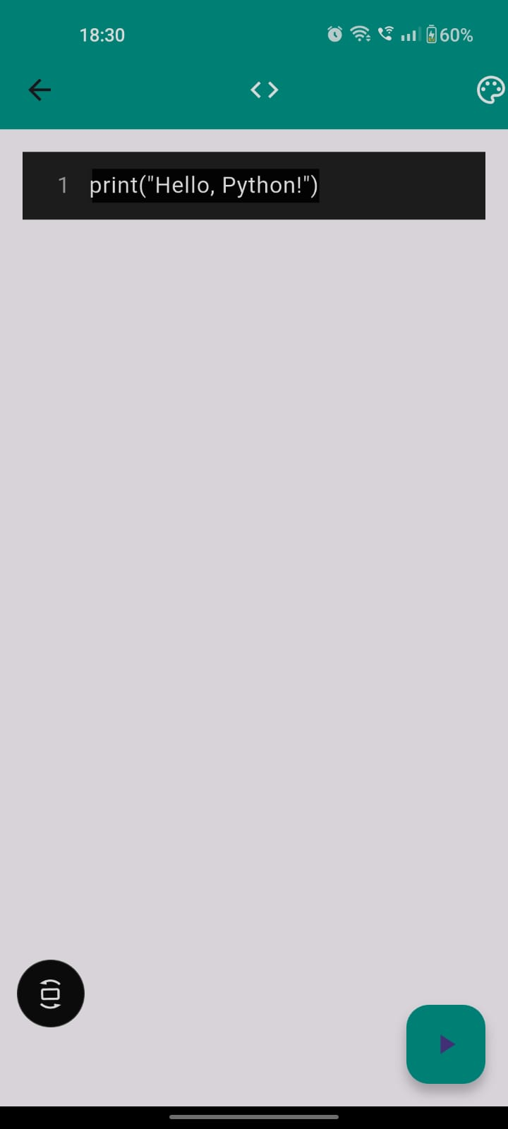
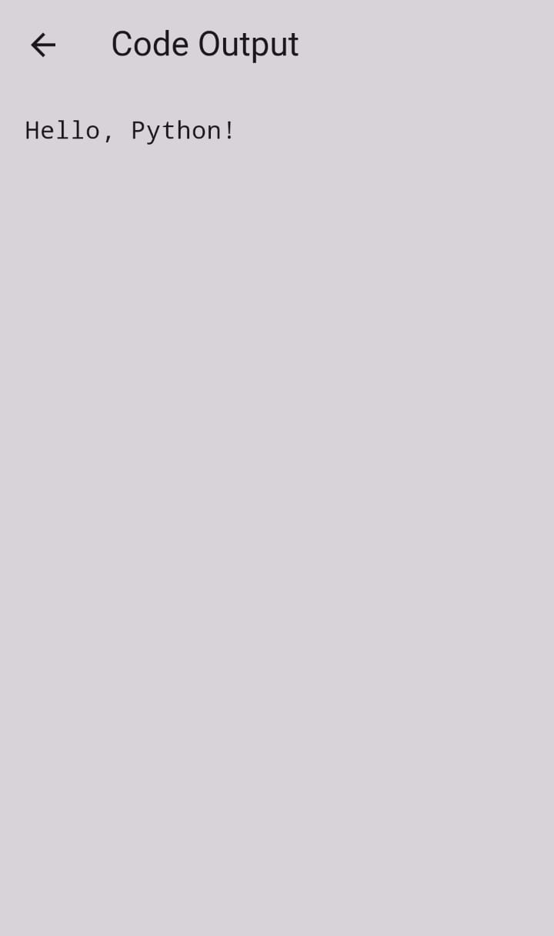
Complier
& Outputs
Compiler module consists of multi- language compiler which allows you to run basic codes of the languages we learn in the app

Slide 17
Thank you!

